Slide 1

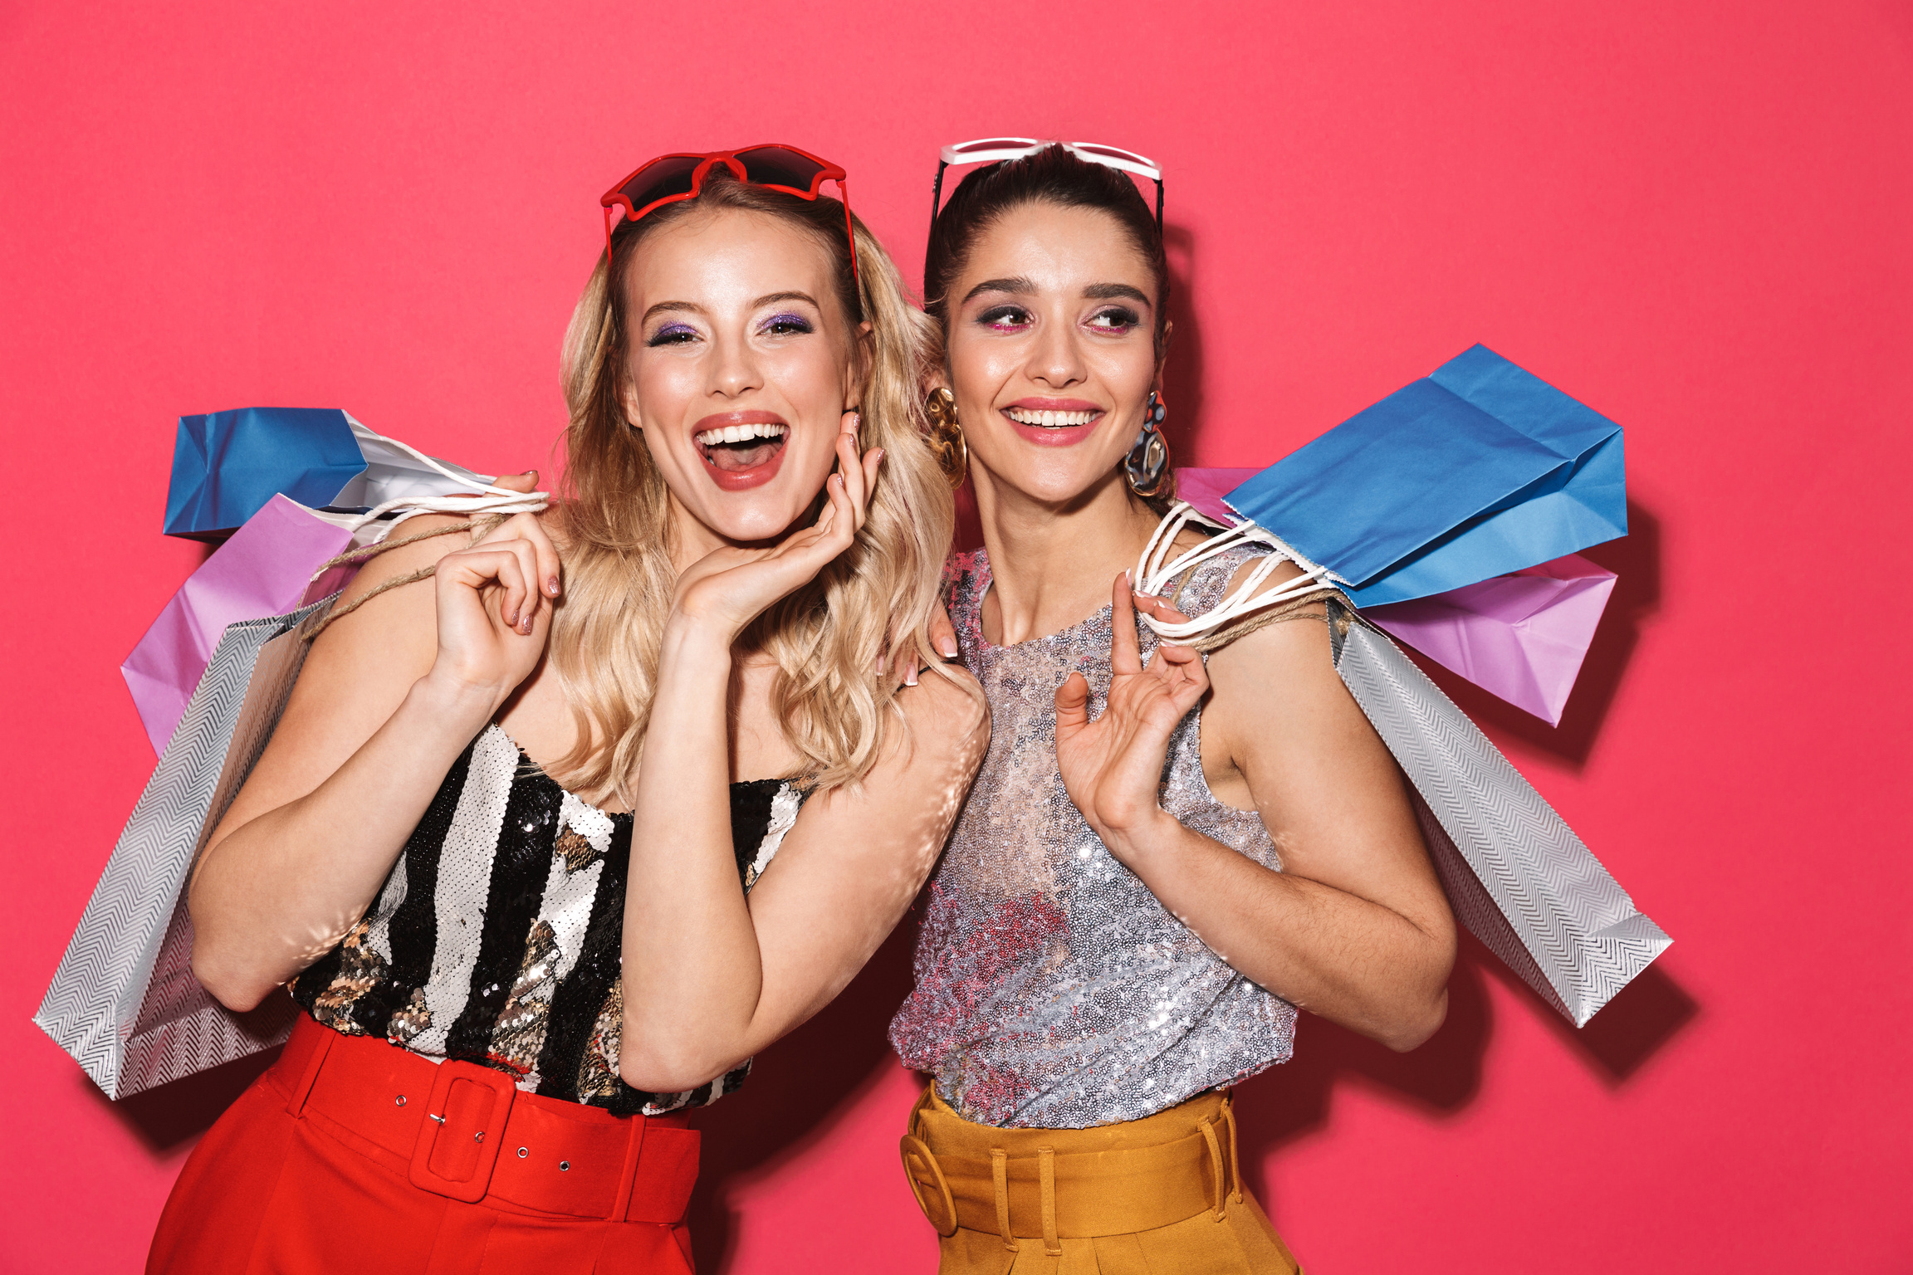

Media Plan
Bihan Li & Emily Diaz
PRAD 563

Slide 2

Background and History of American Eagle Outfitters
Founded: 1977, Pittsburgh, Pennsylvania
Focus: Youth fashion (15-25)
Brands: Denim, casual wear, Aerie brands
Brand values: body positivity, inclusivity, affordability

Slide 3

SWOT Analysis for AE v.s. A&F
Strengths
- AE: Strong brand, affordable, digital engagement.
- A&F: Premium image, global presence.
Weaknesses
- AE: Market saturation, reliant on North America.
- A&F: Past controversies, higher pricing.
Opportunities
- AE: Global expansion, e-commerce growth, expansion in BIPOC community
- A&F: Brand repositioning, new product lines.
Threats
- AE: Economic downturns, fashion shifts.
- A&F: Strong competition, supply chain risks.

Slide 4
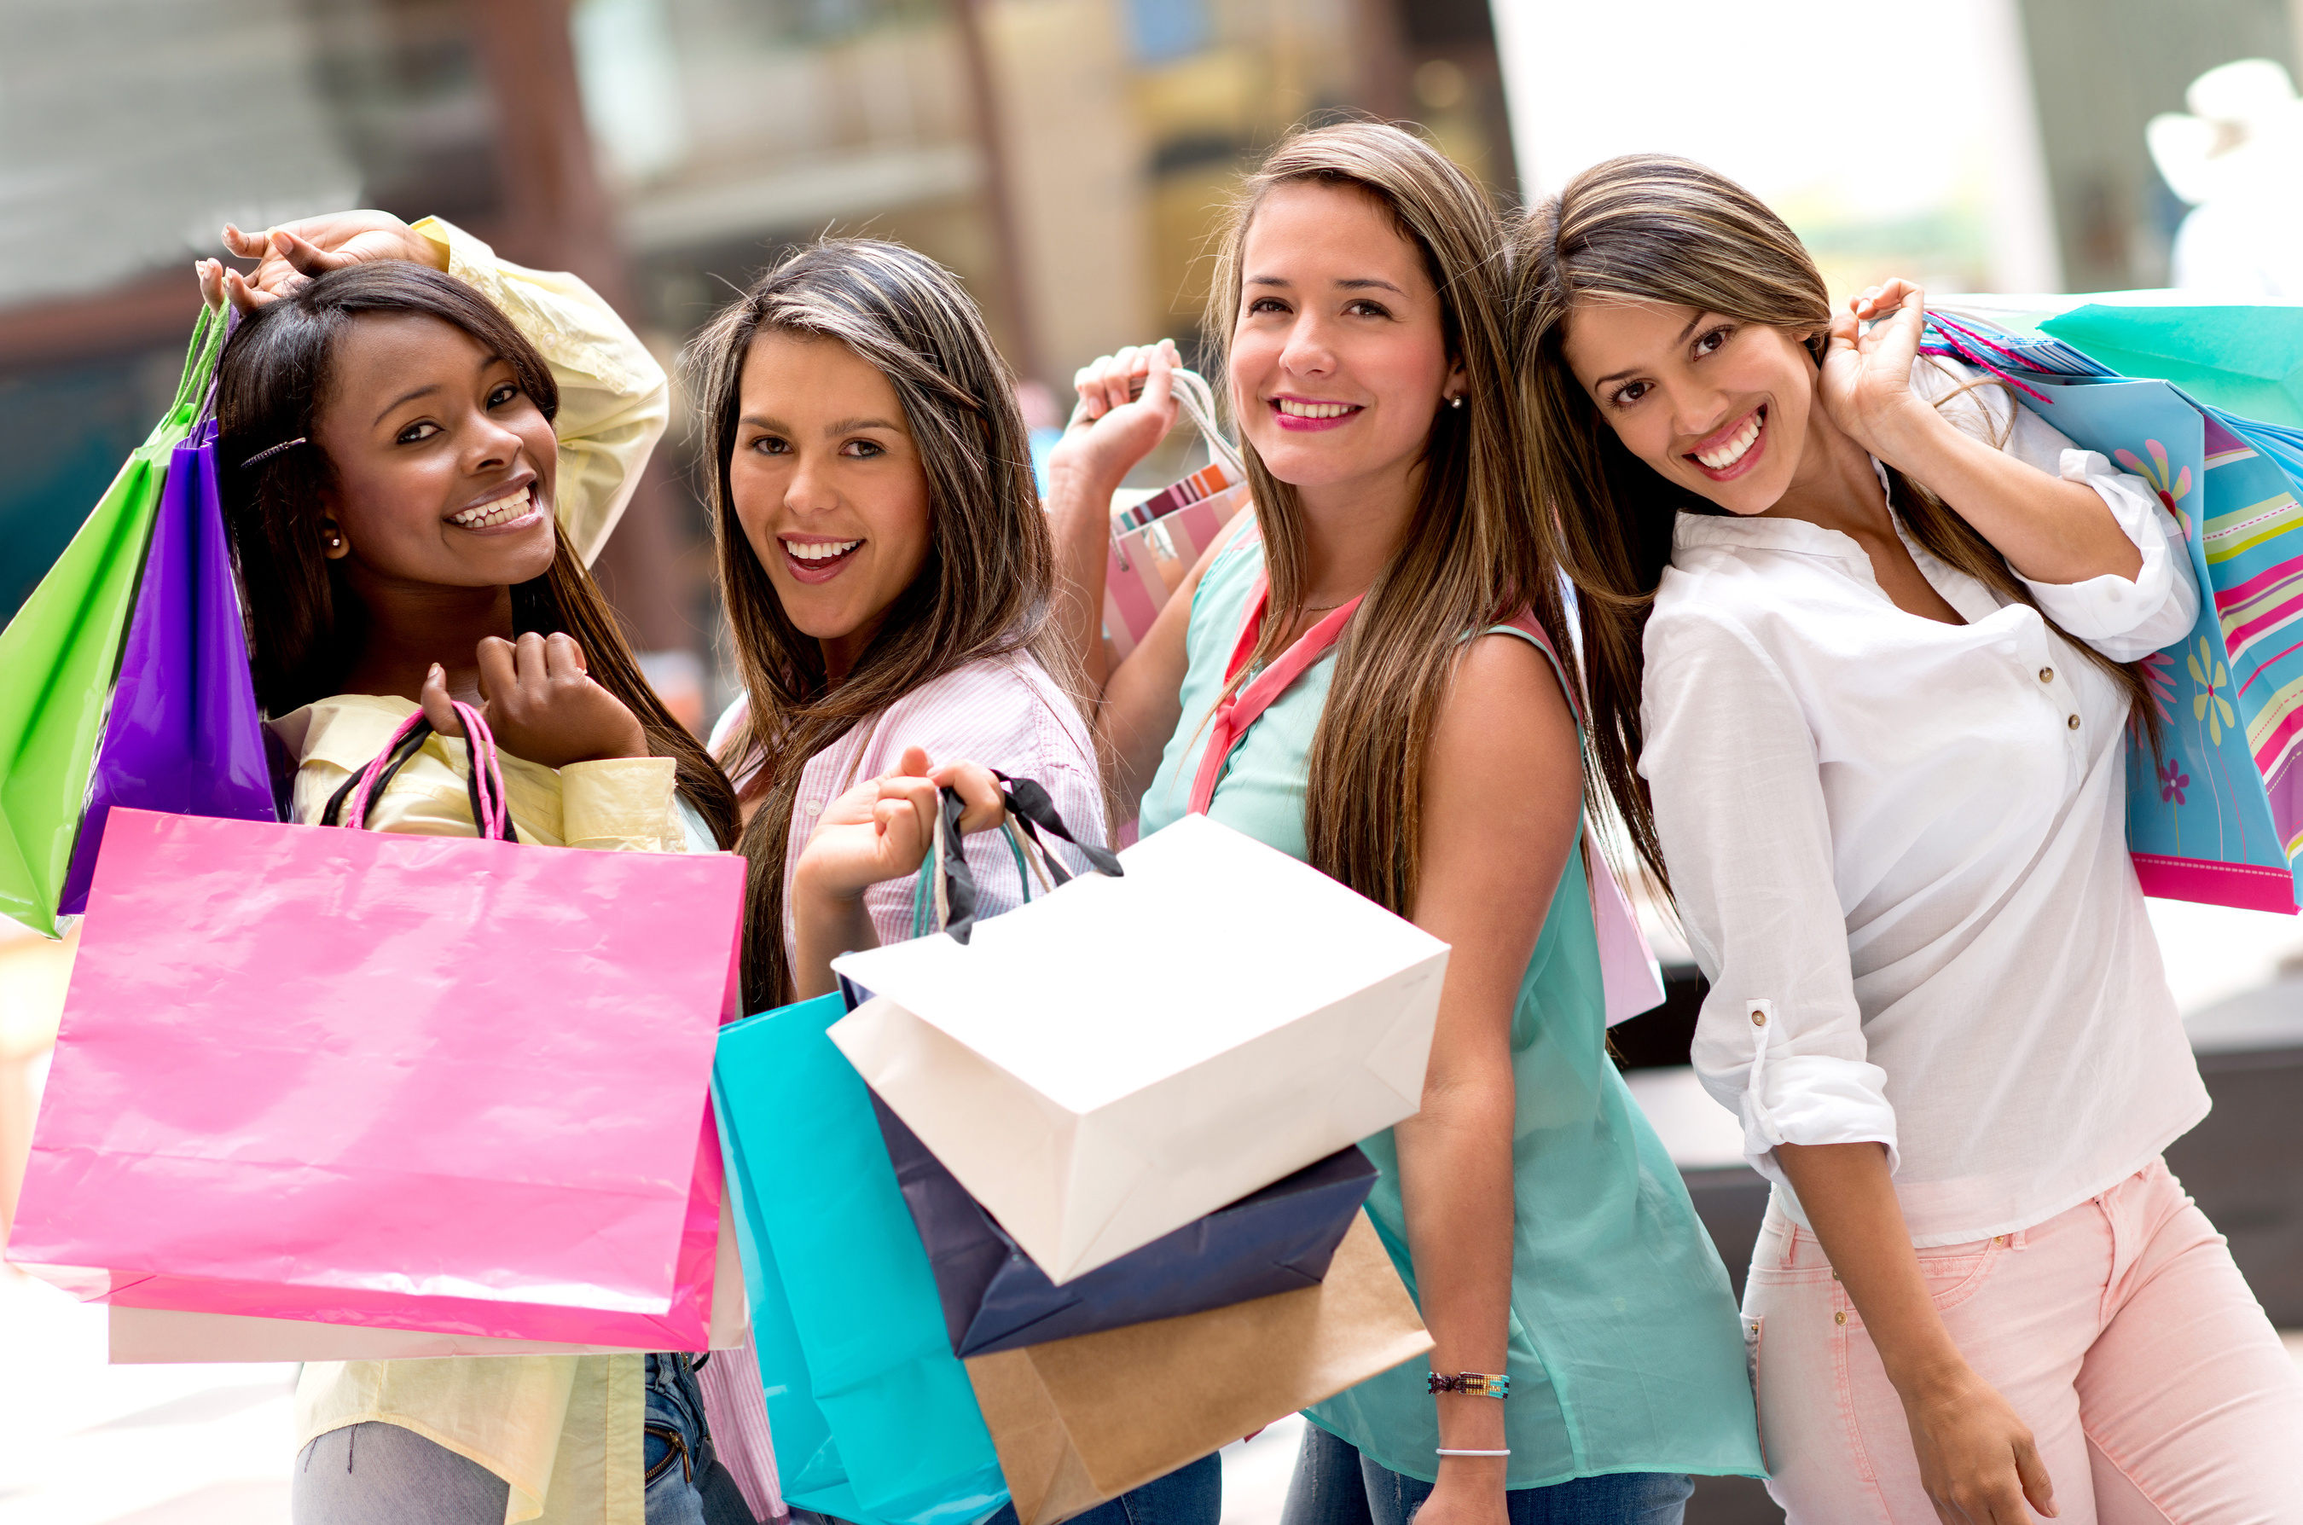

AE Target Audience
American Eagle’s target audience is primarily young, fashion-conscious individuals looking for affordable and stylish clothing.
Demographic Profile:
Age: 15-25 years old, Gen Z
Gender/race: Primarily female, but also popular among men. Typically white.
Income: Middle-income, students & early-career professionals
Occupation: High school and college students, young professionals
Location: Urban areas, college towns
Consumer Behavior: Trend-focused and social-savvy,shop both online & in stores
Our target audience will be young, fashion-conscious women of color looking for affordable clothing.

Slide 5
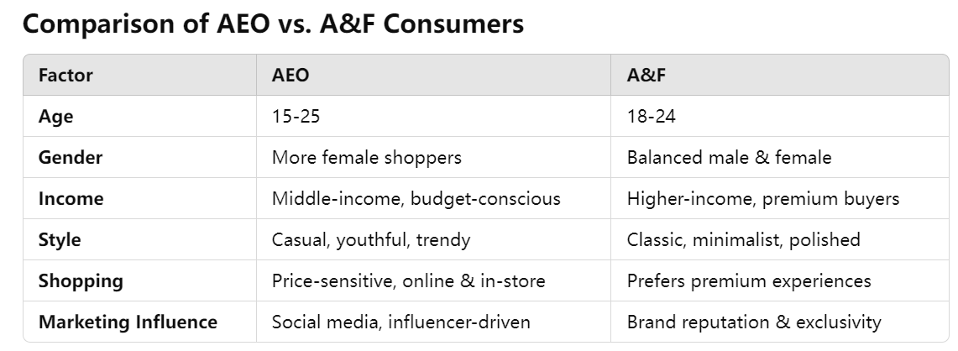
AE v.s. A&F Consumers & Spending
  In 2023, AE did not spend any money on
    digital video
    mobile video
  Places to increase share of voice

Slide 6
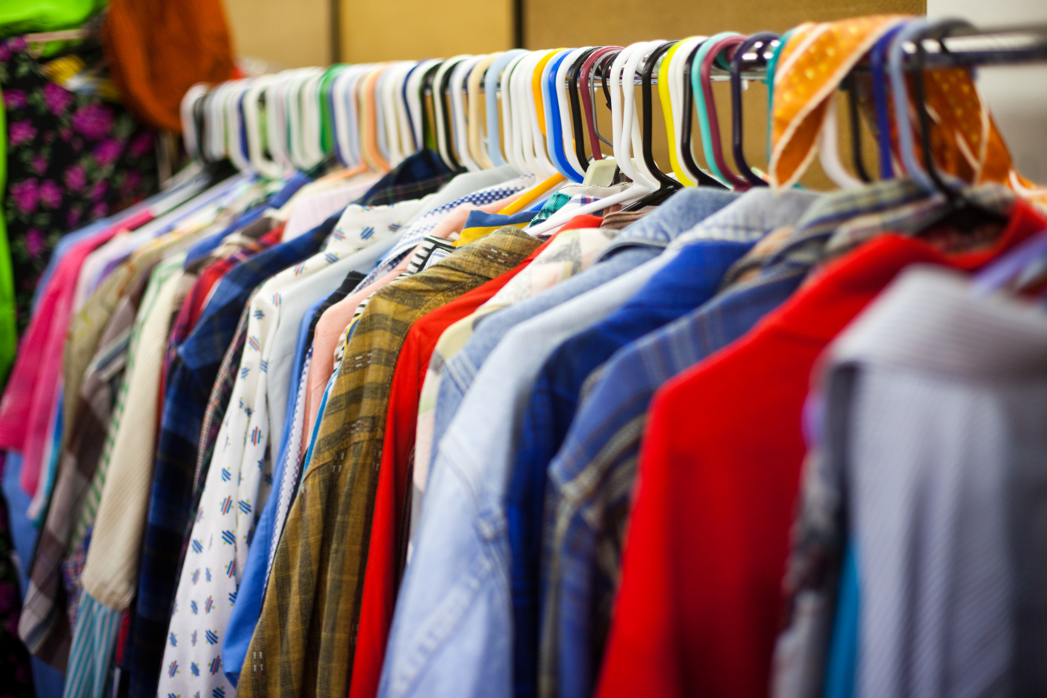

Media Goal
Ad Goal
Marketing Goal
Increase # of BIPOC shoppers at A&E in last 3 months by 50%
Reach 60% (10 mil) of target audience (17mil) by end of 2026
Increase membership/email sign up within target audience by 30% by end of 2026

Slide 7

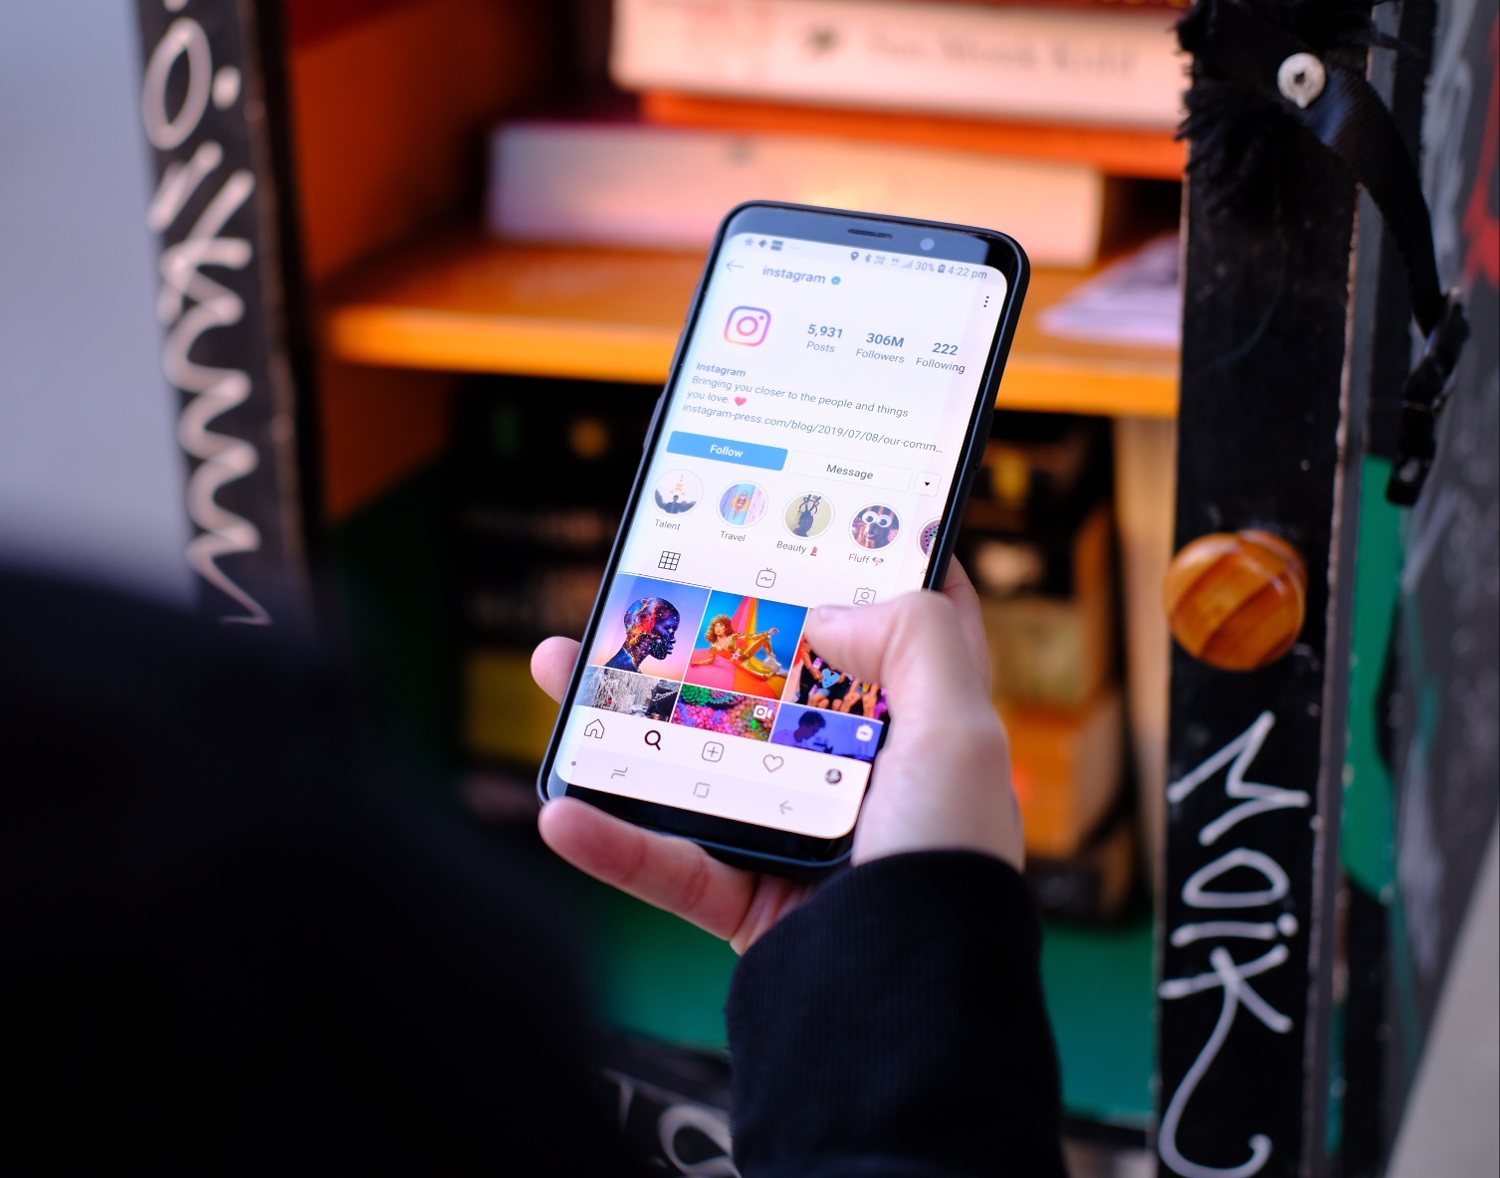

Media Tactics: Paid
Print advertising on public transit; under 25 more likely to use
Digital ads on Instagram/FB
Product placement in TV shows
Digital ads on dating apps like Hinge, avg. age is 25, target audience, clothing recs for date night

Slide 8
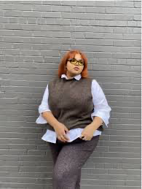



Media Tactics: Earned/Shared
Use the hastag “SupportWOCwithAEO” for feature on their socials
Purchase intent is high for R29, 20% of Gen-Z recently read Vogue
Free product PR packages to influencers on YT, TikTok

Slide 9




Reasoning
TV Streaming - Netflix, Hulu, Tubi
  61% of YA watch TV primarily on streaming
  69% binge-watch TV on streaming- ideal for ad repitition
  Easily reaches target audience again and again
E-mags, social media content
  YA love social media like TikTok, IG, YouTube- easy to reach them
  Paid IG ads with links
  18-44 age range for e-mags, big reach
  Fashion e-mags are hiring more diverse models = diverse readers = potential new customers
Audio - Spotify podcasts or non-premium listeners
  Wide range of podcast listeners (14-35), reaches a lot of target audience
  Mostly female (A&E profile)
  Non-premium = budget friendly = younger people

Slide 10
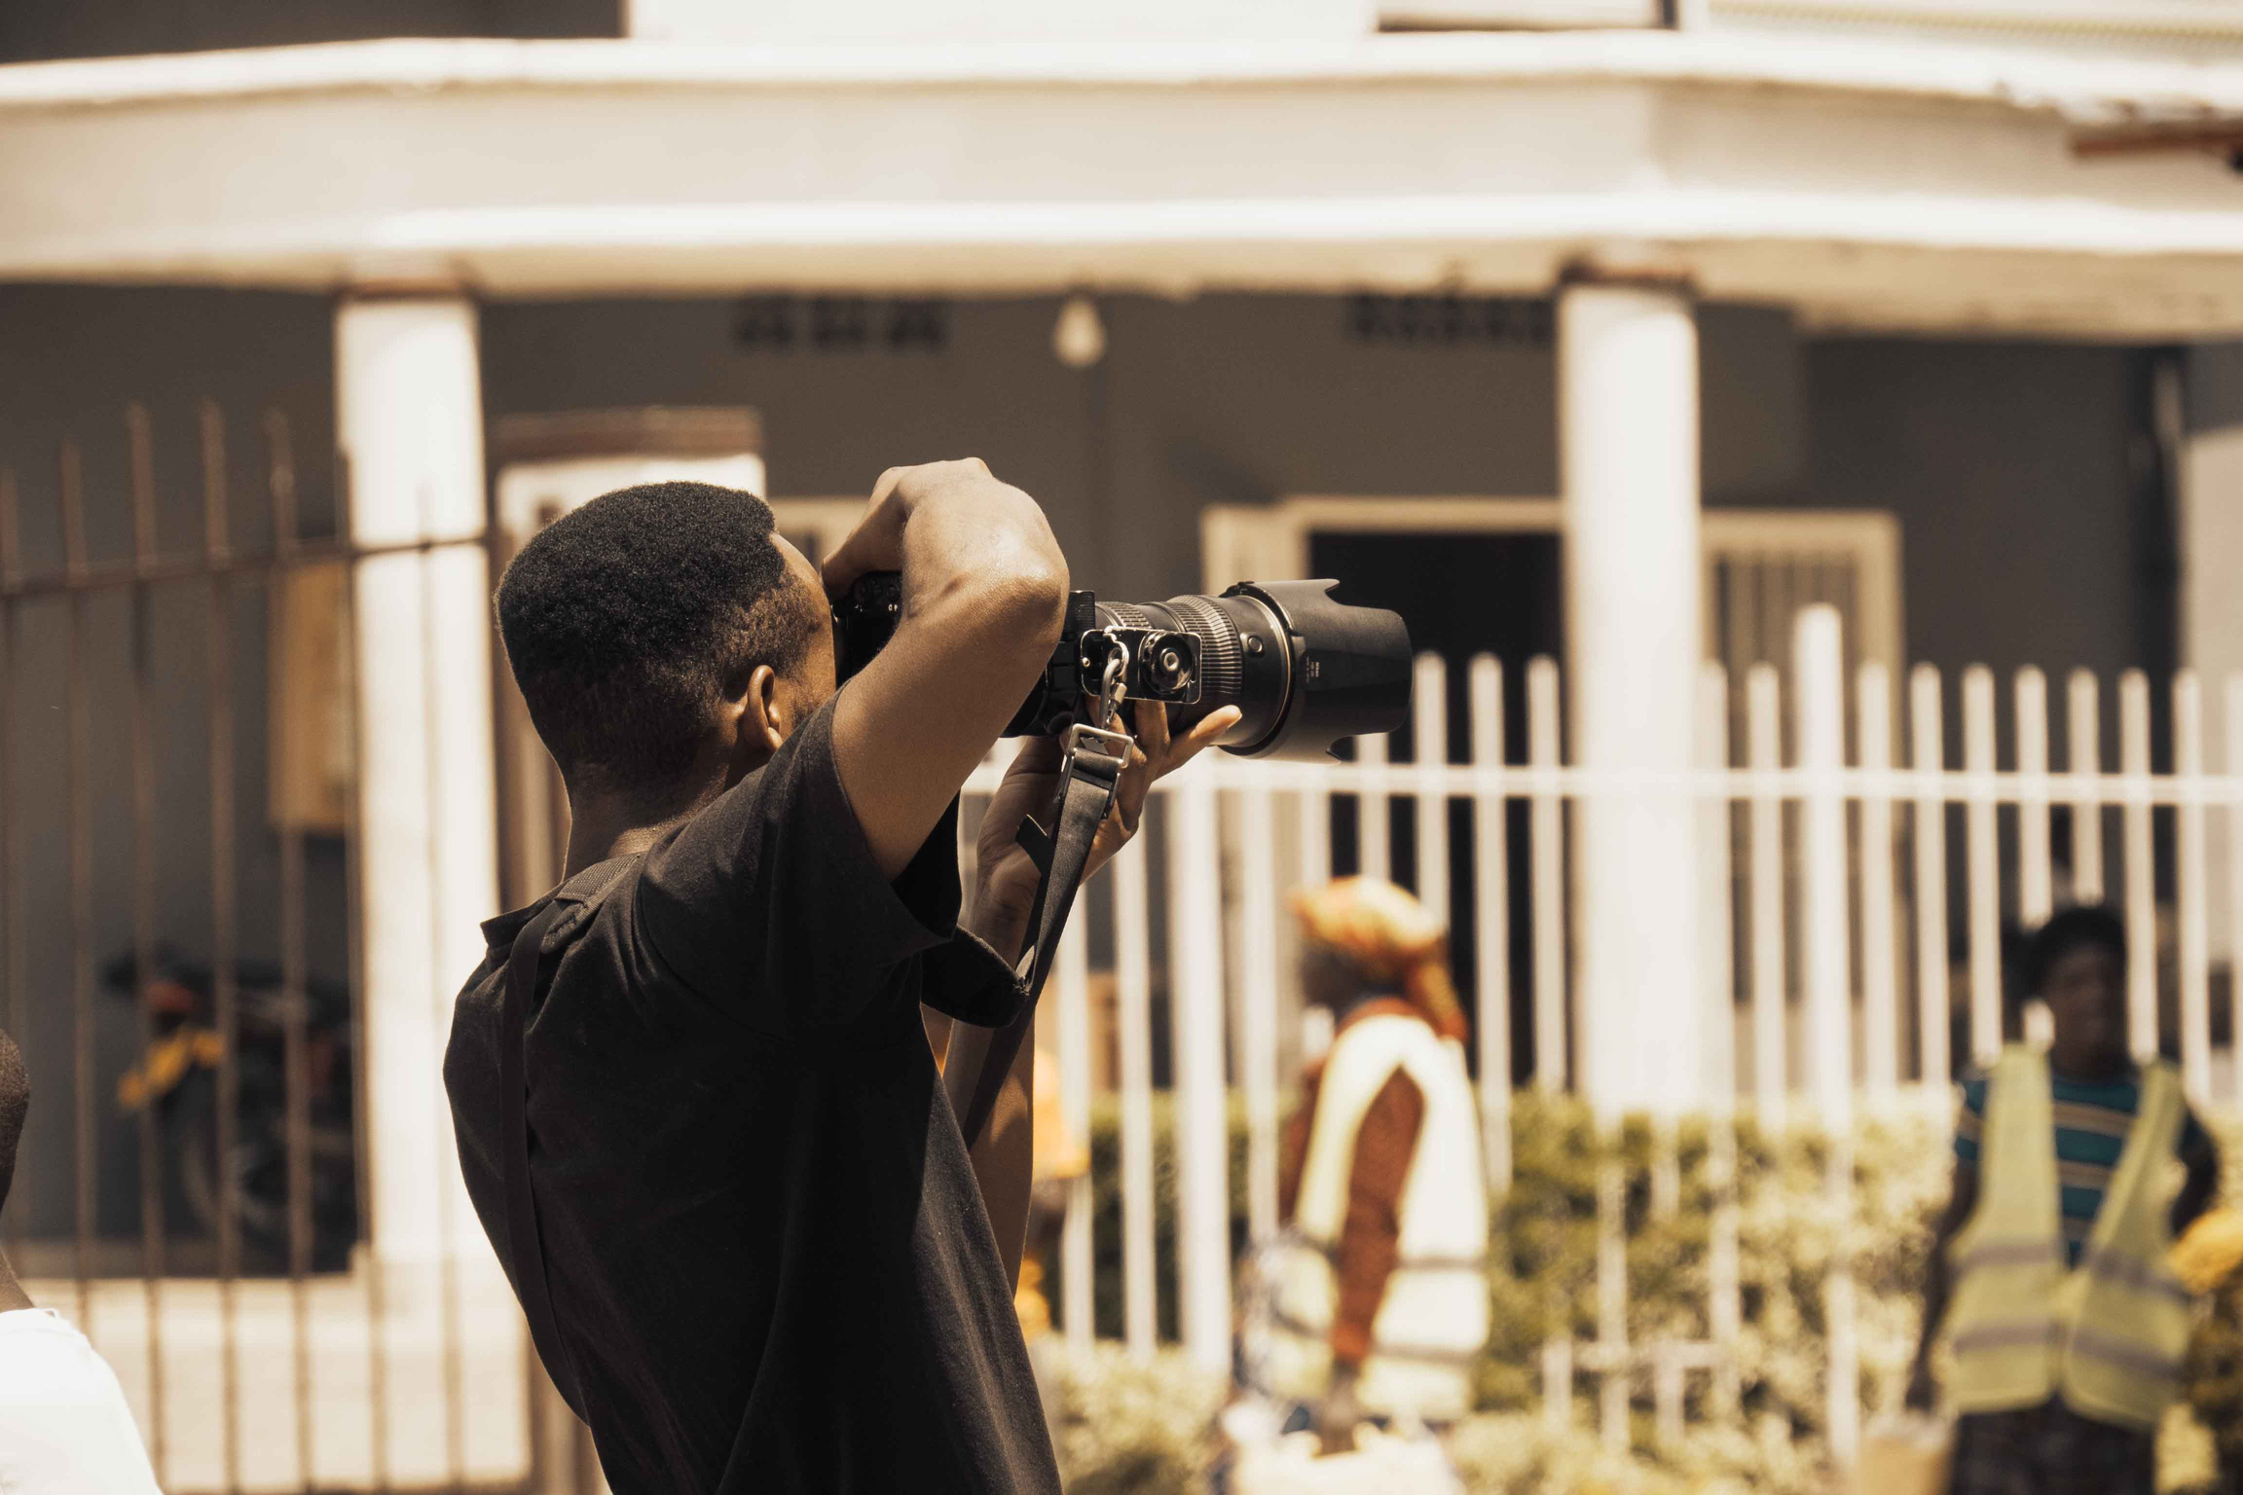
Creative Brief: Short Documentary (owned media)
Project goals:
  Raise brand awareness, affinity and purchase intent within marginalized Gen-Z communities
Target Audience
  Young BIPOC, LGBTQ community and those with disabilities
  Shows brand nuance, accessibility, openings for larger market
Competition: A&F, Urban Outfitters
Project details:
  Following different people as they find their style
  Opening up about how their style showcases their identity, defies beauty standards
  Hire BIPOC/queer/disabled filmmakers
Project message:
  “Find your style and tell your story through A&E”

Slide 11

In-Person Events
Start fund for mental health - % of purchase go to mental health care for YA in schools
  Mental health is top social priority along with healthcare access
  Resonates with Gen-Z’s interest in brand politics and mission
Attend different colleges for self-care pop-ups
  Free A&E self-care packages with store products
  TikTok videos giving free packages to students on campus
  Talk about importance of mental health awareness
Back to school charity
  Letting teens pick free outfits in store, showcasing different styles
  Style should be accessible, clothes are more than fabric, they’re self-expression

Slide 12

Budget Breakdown & Scheduling
  Social media/Digital: $13mil (29%)
  TV Streaming: $9mil (20%)
  In-person events: $7mil (15%)
  E-mags/blogs: $6.5mil (14%)
  Music streaming audio: $4.5mil (10%)
  Print: $4.5mil (10%)
  Continuous advertising with flighting during Christmas season, summer and back to school
    Promoting sales, new trends
  Documentary release in November for Christmas - “giving back”

Slide 13
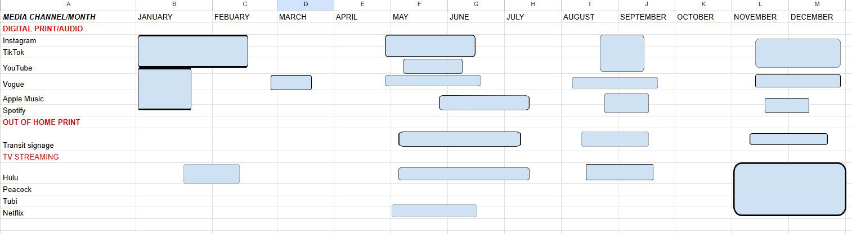
Impressions
  Referencing class media rate card for women aged 18+
  Social media : ~520mil
    (13mil/25) x 1000
  Print ads: ~643mil
    (4.5mil/7)x1000
  Digital audio: 750mil
    (4.5mil/6)x1000
  Mobile, TV streaming: 45mil
    (9mil/5)x1000
  Mobile, e-mags/blogs: 32.5mil
    (6.5 mil/5)x1000

Slide 14
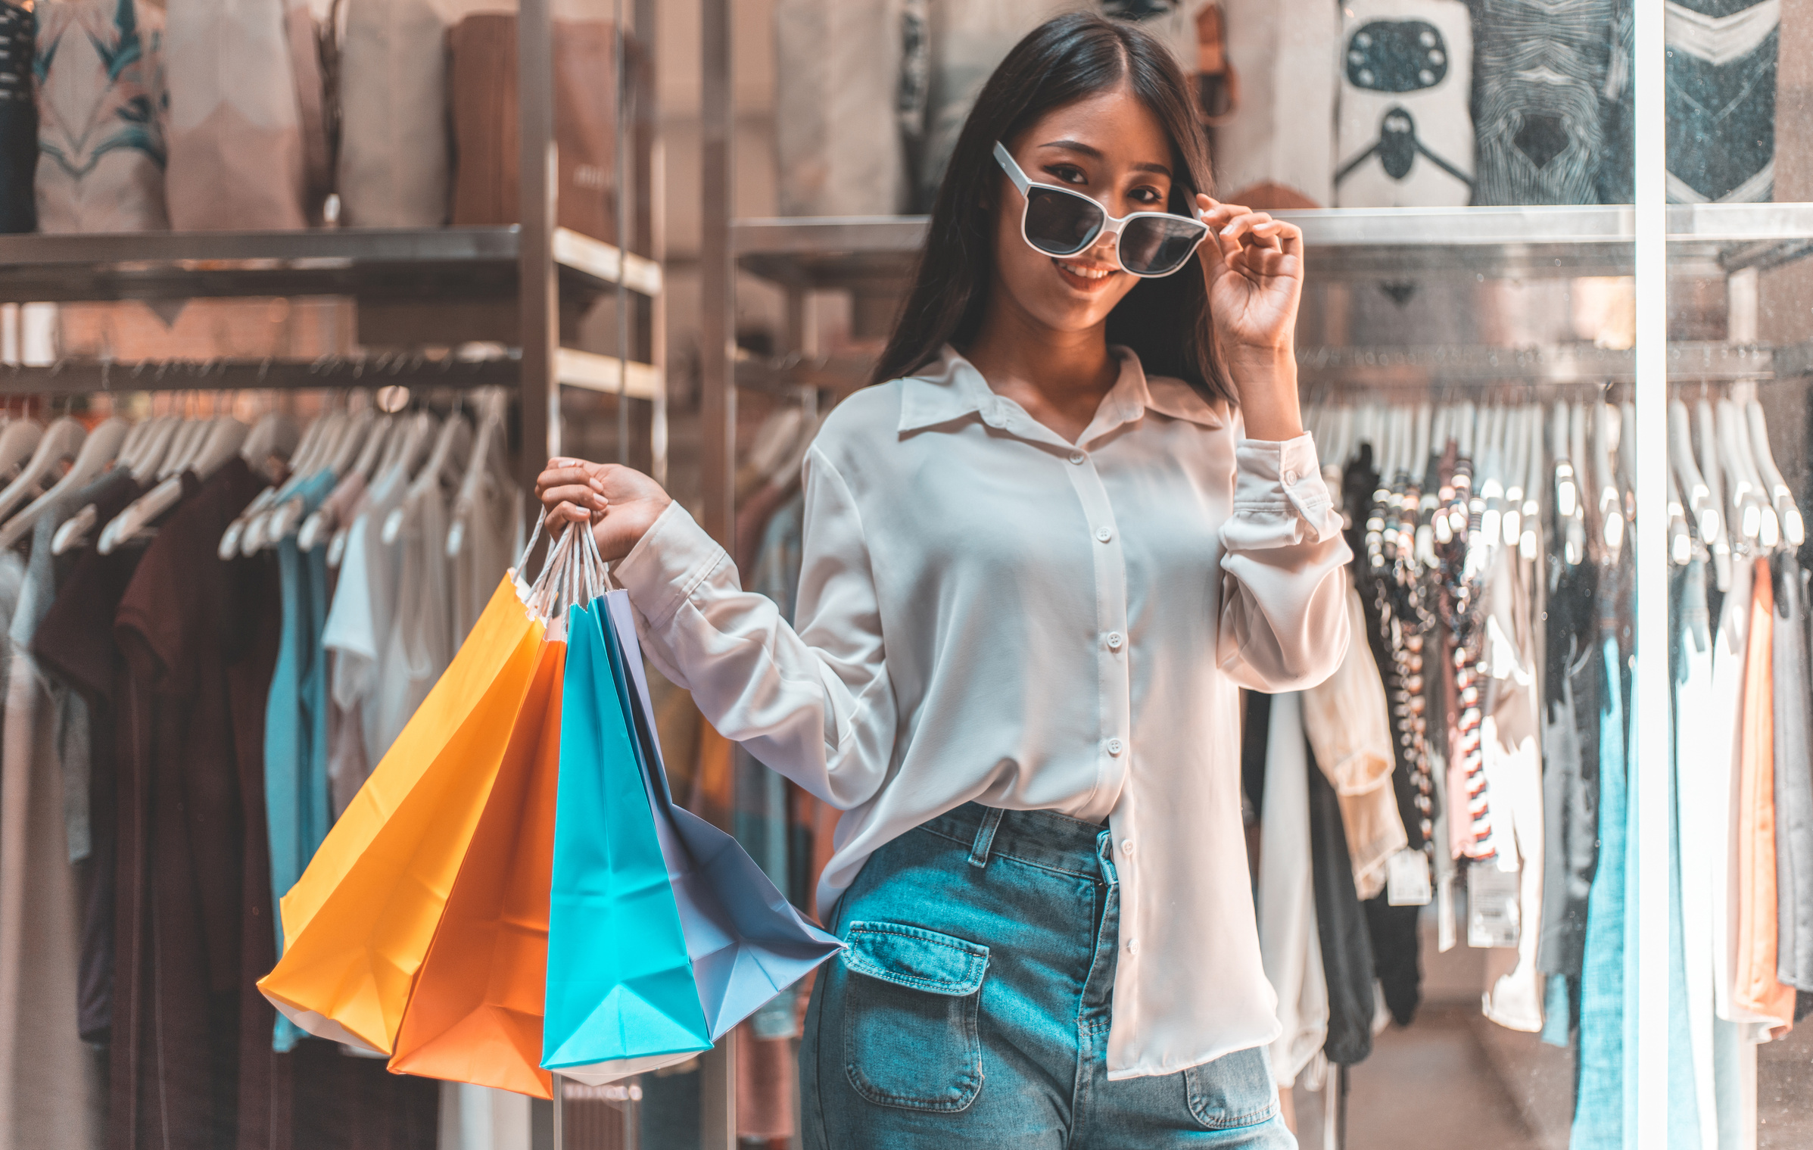
Evaluation & Alternatives
How Should We Evaluate Our Plan?
  Brand Awareness & Reach – Impressions, reach, frequency
  Engagement & Consumer Interaction – CTR, VCR, social engagement
  Sales & Conversion – Website traffic, conversion rates, in-store sales lift
  Competitive Benchmarking – Compare SOV & ROI
What Could We Do with a Larger Budget?
  Expand Digital Video & Mobile Video Ads – YouTube, TikTok, Streaming platforms
  Strengthen Local Market Penetration – Local radio, community events, geo-targeted ads
  Leverage High-Impact Ad Formats – Interactive shoppable ads, AR/VR experiences
  Explore New Media Channels – Podcast ads, digital billboards
  Boost Paid Social & Influencer Partnerships – Expand KOL collaborations

Slide 15
Citations
  American Eagle Outfitters. (2023). Annual Report 2023. Retrieved from https://www.aeo-inc.com
  Business of Fashion. (2023). Abercrombie & Fitch’s Revival: How the Brand Transformed Its Image. Retrieved from https://www.businessoffashion.com
  Forrester Research. (2023). The Power of Digital Video and Social Media in Retail Marketing. Retrieved from https://www.forrester.com
  McKinsey & Company. (2022). The State of Fashion: How Gen Z is Shaping the Retail Industry. Retrieved from https://www.mckinsey.com
  National Retail Federation (NRF). (2023). Gen Z Shopping Trends: Digital Influence and Social Media’s Role in Retail. Retrieved from https://nrf.com
  PwC. (2023). The Future of Retail Media and Advertising: Consumer Engagement Strategies. Retrieved from https://www.pwc.com
  Statista. (2023). American Eagle Outfitters Market Share and Brand Positioning. Retrieved from https://www.statista.com
  WGSN. (2023). Youth Fashion Trends: American Eagle vs. Abercrombie & Fitch in the US Market. Retrieved from https://www.wgsn.com

Slide 16

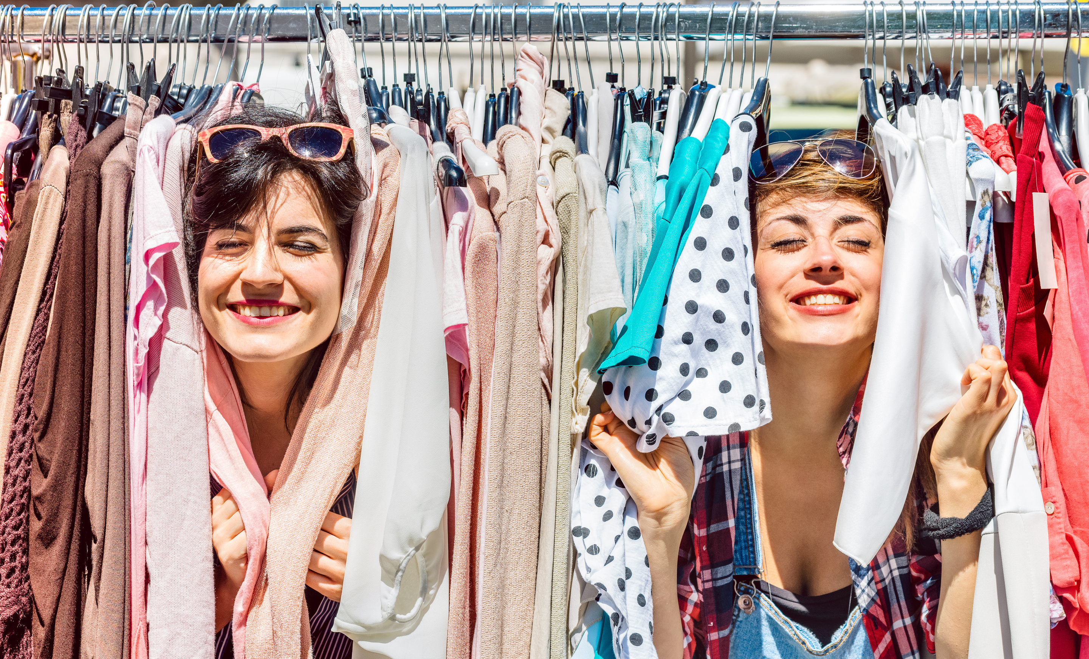
Thank you!

